Slide 1
Employee Data Analysis using Excel
STUDENT NAME:ABINESH A
REGISTERNO:312214357/B67AB26F30BD3828867415FC7AB6DA37
DEPARTMENT: B.COM
COLLEGE: ST.THOMAS COLLEGE OF ARTS AND SCIENCE

Slide 2



PROJECT TITLE
Employee Performance Analysis using Excel

Slide 3


AGENDA
Problem Statement
Project Overview
End Users
Our Solution and Proposition
Dataset Description
Modelling Approach
Results and Discussion
Conclusion
3/21/2024 Annual Review

Slide 4

PROBLEM STATEMENT
Track attendance and absenteeism
Evaluate sales performance or revenue generation
Assess task completion rates or productivity
Analyze customer satisfaction ratings or feedback
Compare performance across different departments or teams

Slide 5

PROJECT OVERVIEW
Collect and organize employee performance data
Set up an Excel dashboard to visualize performance metrics
Create formulas and charts to analyze and compare performance
Identify areas for improvement and track progress over time
An Excel workbook with a user-friendly dashboard2. Clear and concise performance metrics and charts3. Formulas and calculations to analyze performance data4. Recommendations for future performance improvement initiatives

Slide 6
WHO ARE THE END USERS?
HR Generalists: To track employee performance, identify training needs, and inform talent management decisions.
Team Managers: To monitor team performance, set goals, and provide targeted feedback to team members.
Department Heads: To evaluate departmental performance, make informed decisions, and optimize resource allocation.
Business Analysts: To analyze performance trends, identify areas for improvement, and recommend data-driven solutions.
Operations Managers: To track key performance indicators (KPIs), optimize processes, and enhance overall efficiency.

Slide 7
OUR SOLUTION AND ITS VALUE PROPOSITION
CONDITIONAL FORMATTING – MISSING
FILTER- REMOVE
FORMULA- PERFORMANCE
PIVOT-SUMMARY
GRAPH-DATA VISUALIZATION

Slide 8
Dataset Description
Employee= KAGGLE
26-Features
9-Features
Emp Id- Number
Name Text
Emp- Type
Current Employee Rating- Number
Gender- Male Female
Employee Rating –Number

Slide 9

THE "WOW" IN OUR SOLUTION
=IFS(Z8>=5,”VERY HIGH”,Z8>=4,”HIGH”,Z8>=3,”MED”,TRUE,”LOW”)
3/21/2024 Annual Review
9

Slide 10
MODELLING
Data Preparation
Import and clean employee data (e.g., demographics, job info, performance metrics)
Ensure data quality and consistencyII.
Descriptive Analytic
Create summaries and visualizations (e.g., tables, charts, graphs) to understand
Employee demographics (e.g., age, gender, department)
Job characteristics (e.g., role, tenure, salary)
Current Employee Rating (e.g., ratings, promotions, turnover)
Inferential Analytics
Correlation analysis (e.g., between performance and salary)
Regression analysis (e.g., predicting turnover based on demographics)
Cluster analysis (e.g., grouping similar employees)
10

Slide 11
RESULTS
Prescriptive Analytics
Talent development and training programs
Diversity, equity, and inclusion initiatives
Compensation and benefits strategies
Employee engagement and retention plan
PivotTables
PivotTables and Power Pivot for data summarization and analysis
Conditional Formatting and Color Scales for data visualization-
Regression and Correlation analysis using Excel's built-in functions
Solver and Scenario Manager for optimization and forecasting

Slide 12
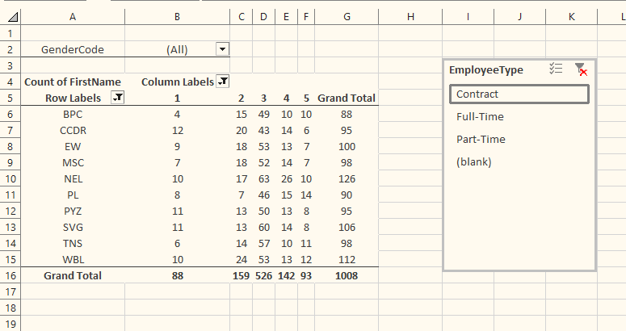
RESULTS
12

Slide 13
RESULTS

Slide 14

Conclusion
We have identified trends, patterns, and correlations that will inform our decision-making and drive business outcomes. Specifically, we have:
Identified areas of high employee turnover and absenteeism, allowing us to target retention strategies
Analysed salary and benefits data to ensure equity and competitiveness
Visualized employee performance metrics to inform development and promotion decisions
Detected correlations between training programs and job satisfaction, highlighting areas for investment
Created data-driven recommendations to enhance employee engagement, productivity, and overall business performance

